Slide 1
Big Data in Industry-Use Cases
Dr Milan Joshi

Slide 2
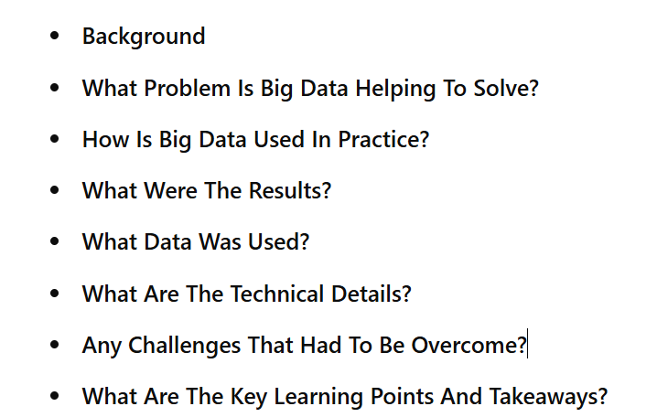
Agenda
Name of Company
of Company

Slide 3

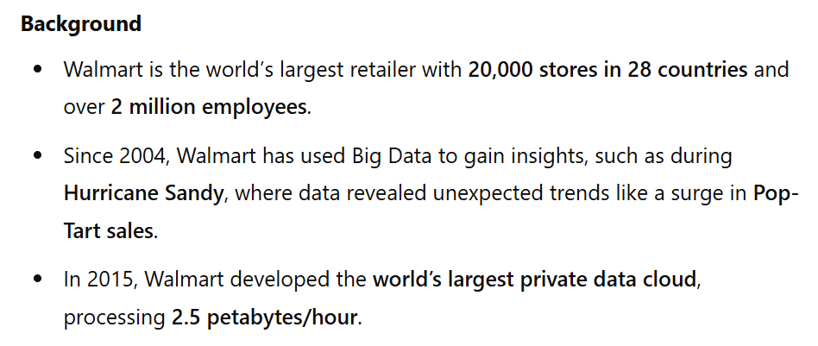

Slide 4
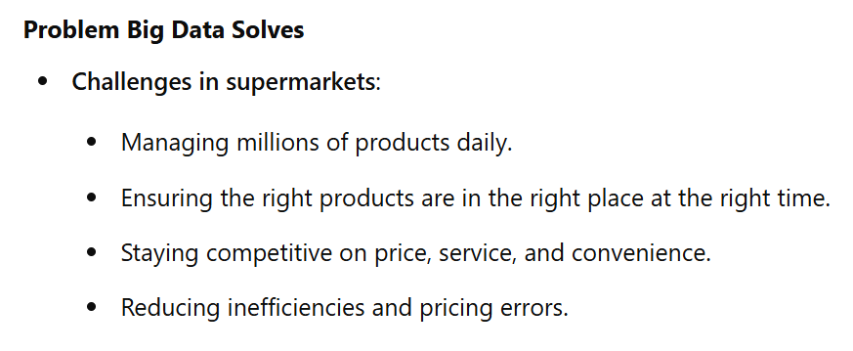

Slide 5
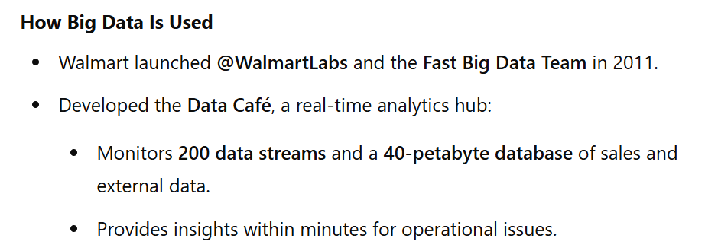

Slide 6
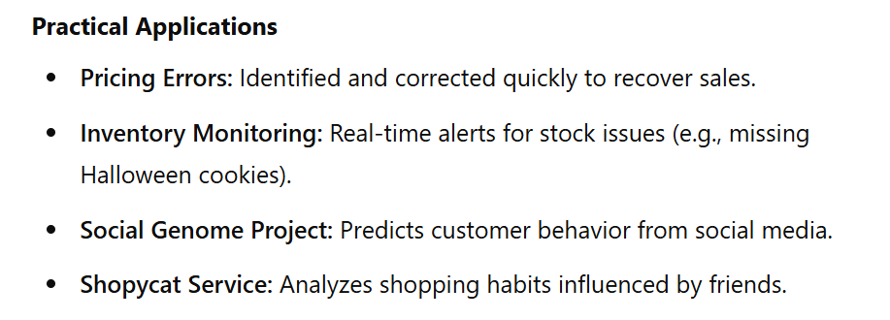

Slide 7
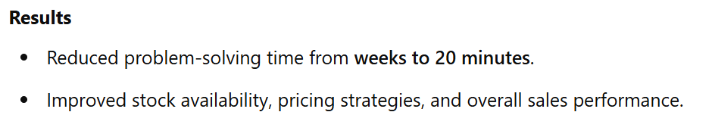

Slide 8
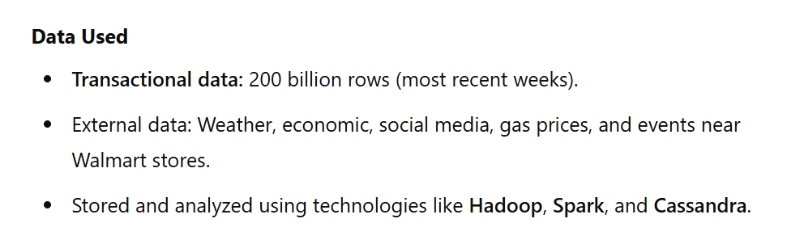

Slide 9
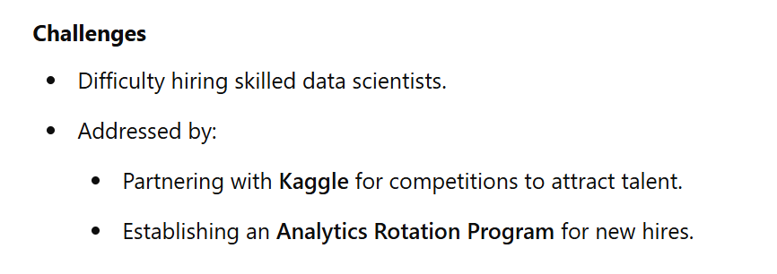

Slide 10
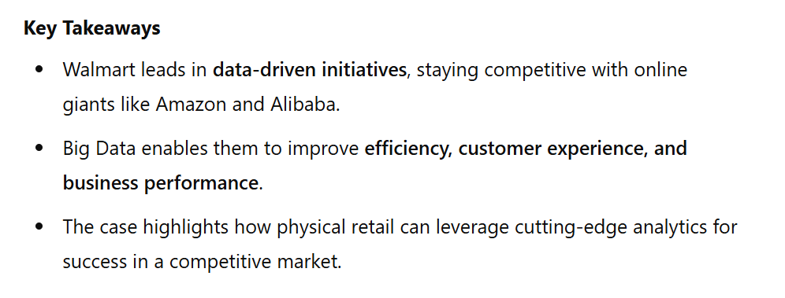

Slide 11


Slide 12
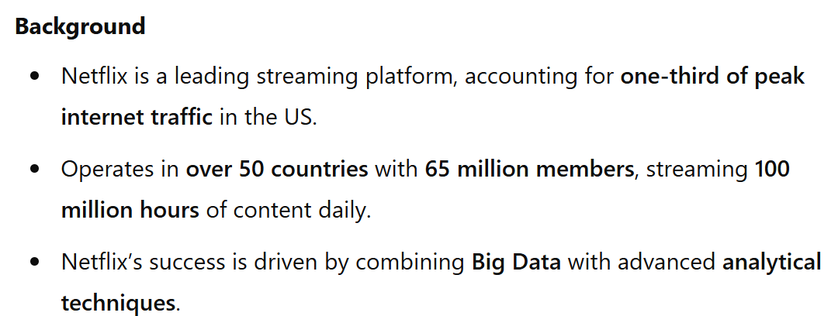

Slide 13
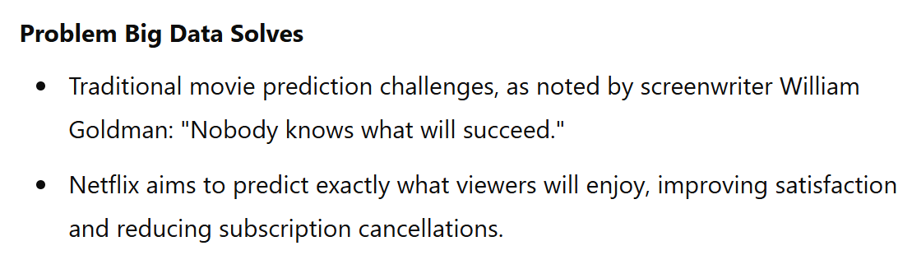

Slide 14
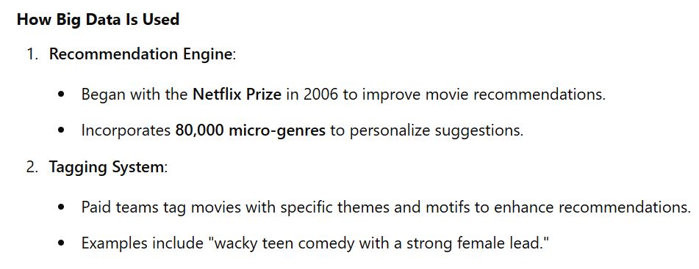
Instead of just "Romantic Comedy," a micro-genre could be "Romantic Comedies Featuring Time Travel."

Slide 15
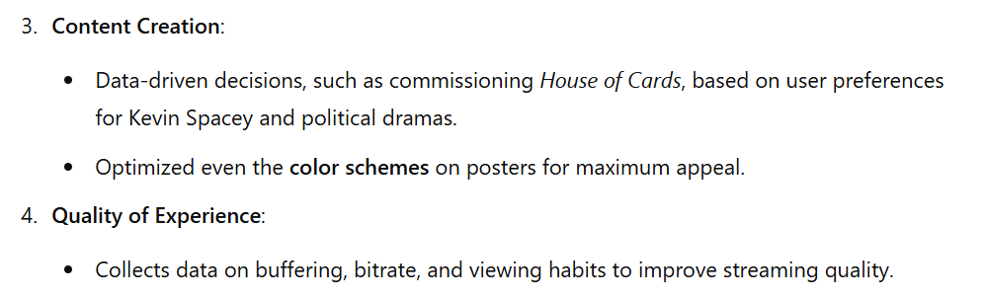

Slide 16
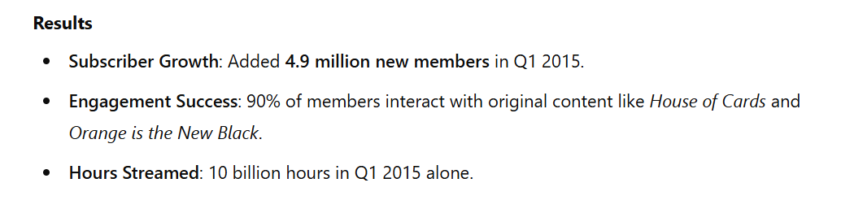

Slide 17
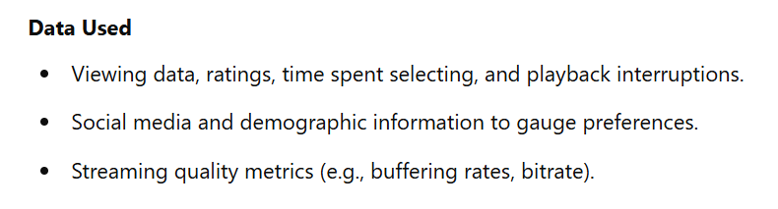

Slide 18
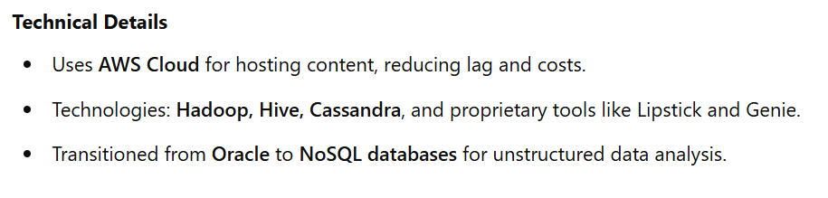

Slide 19
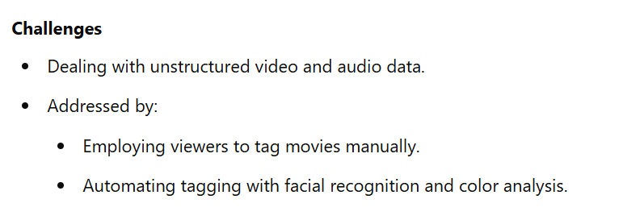

Slide 20
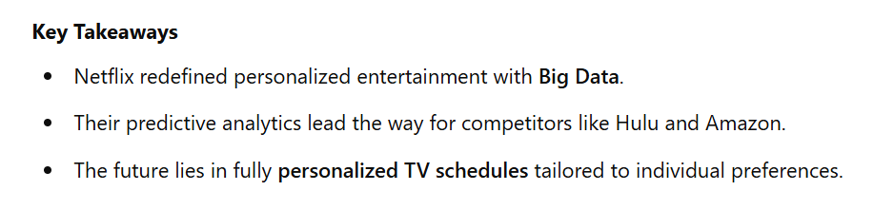

Slide 22
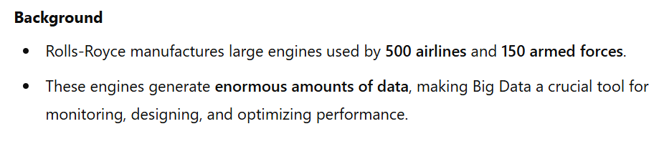

Slide 23
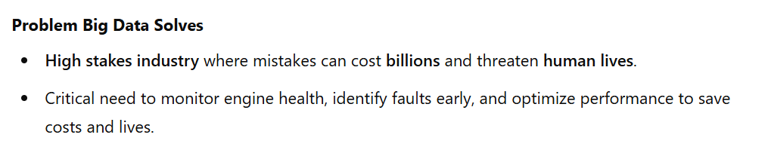

Slide 24
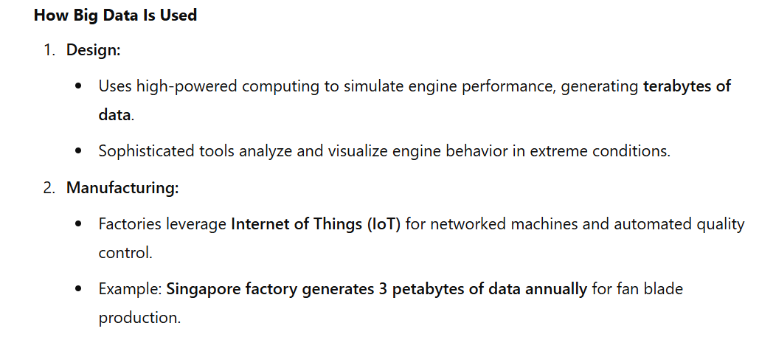

Slide 25
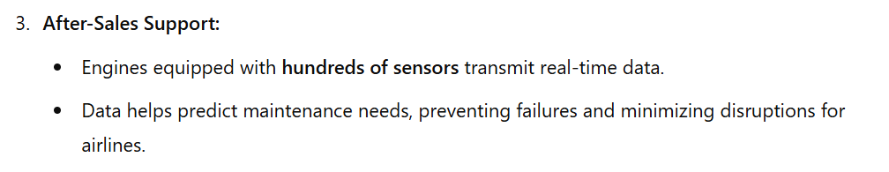
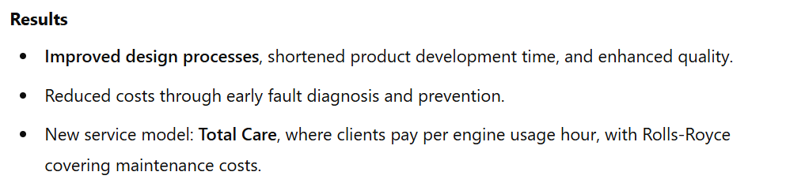

Slide 26
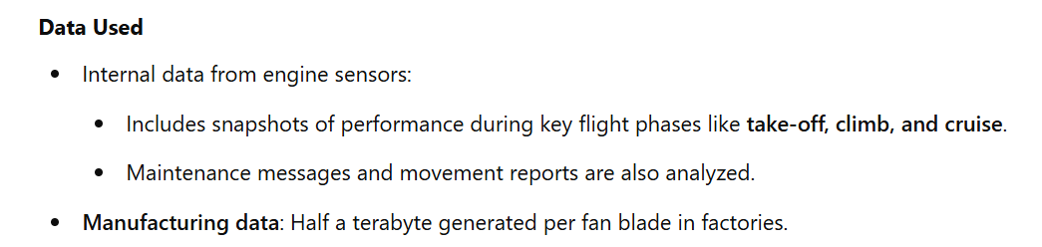

Slide 27
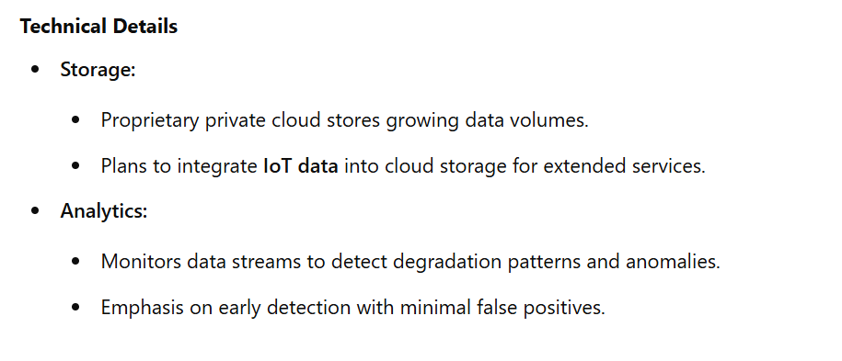

Slide 28
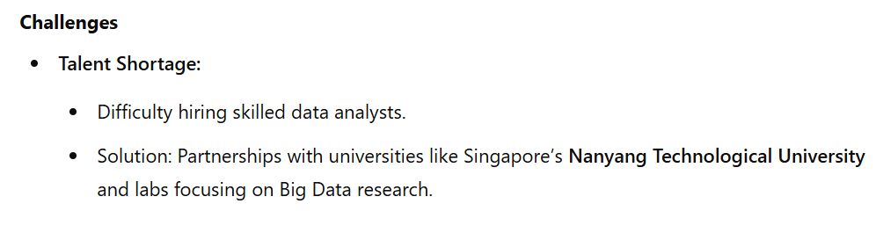

Slide 29
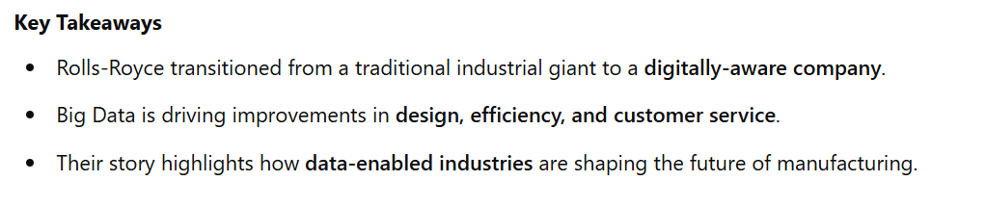

Slide 31
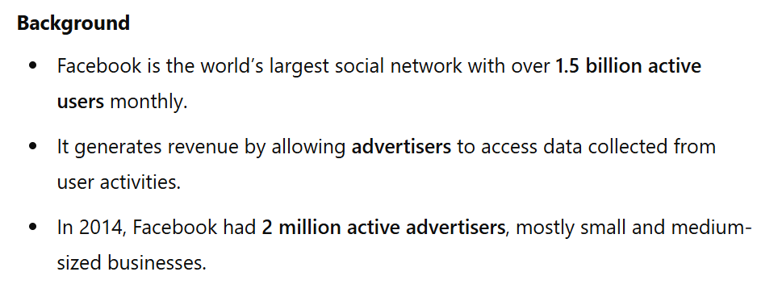

Slide 32
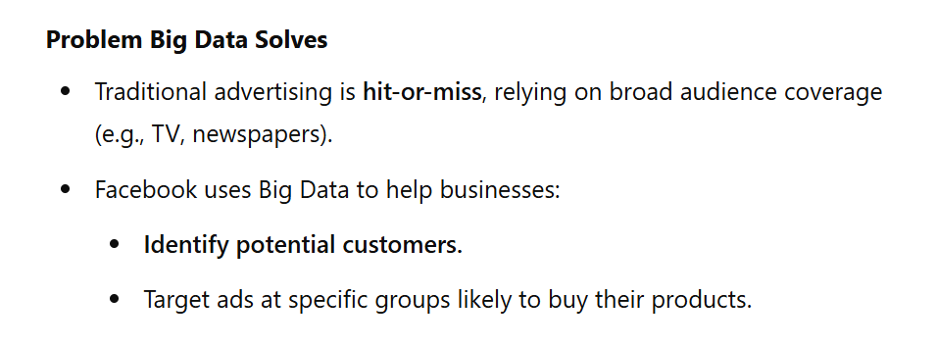

Slide 33
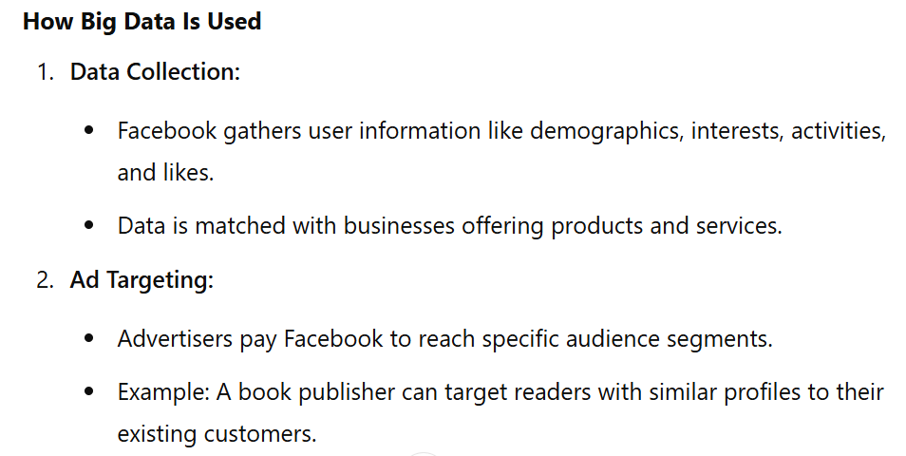

Slide 34
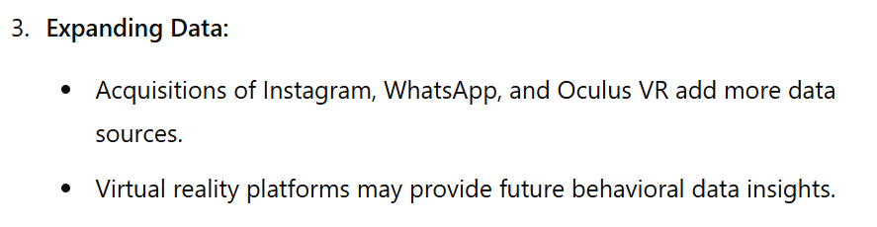
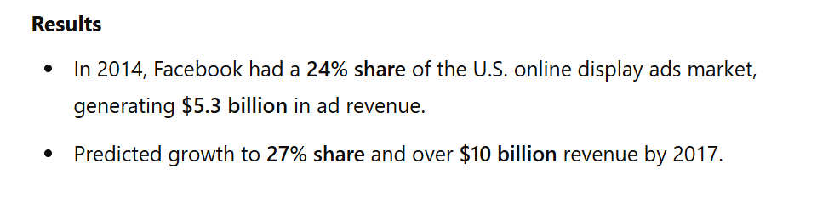

Slide 35
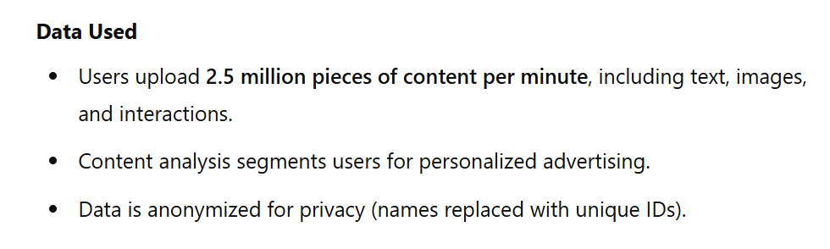

Slide 36
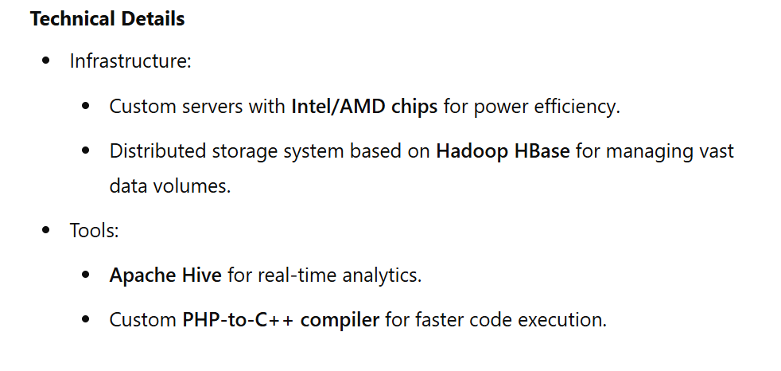

Slide 37
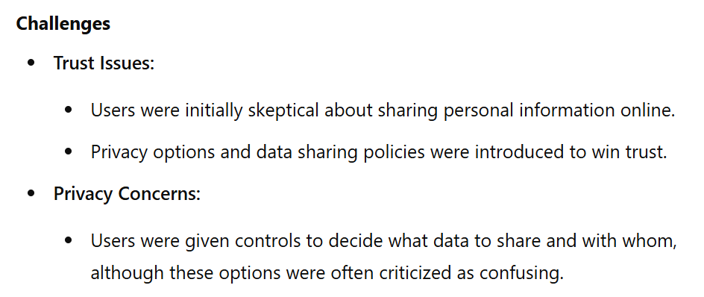

Slide 38
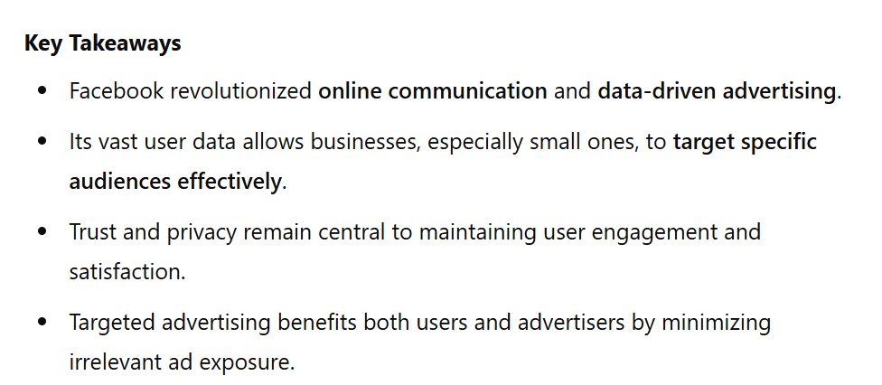

Slide 40
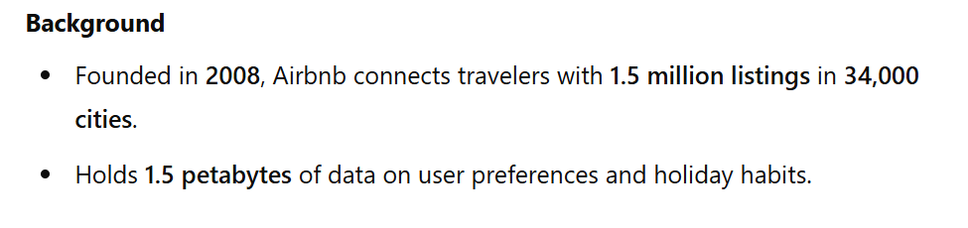

Slide 41
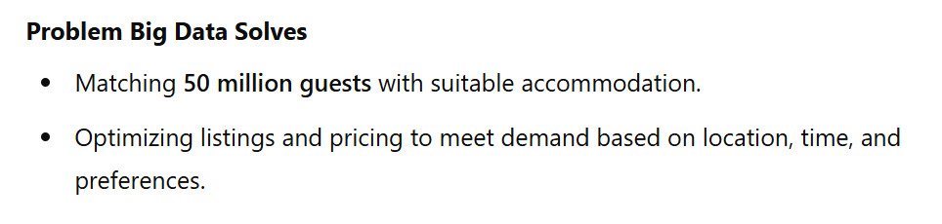

Slide 42
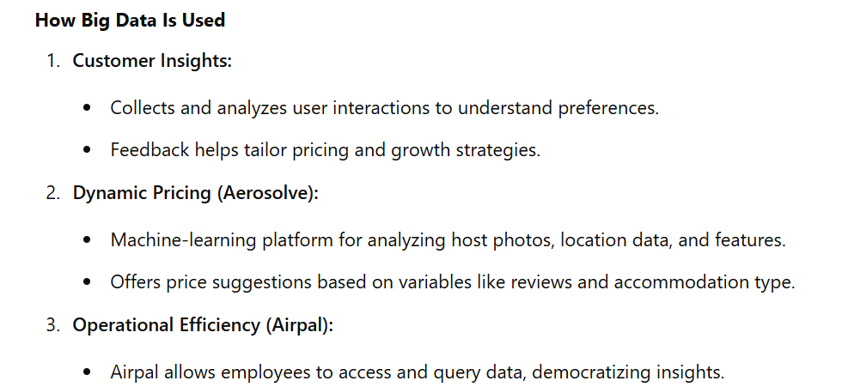

Slide 43
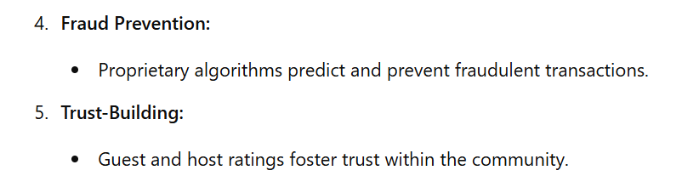

Slide 44
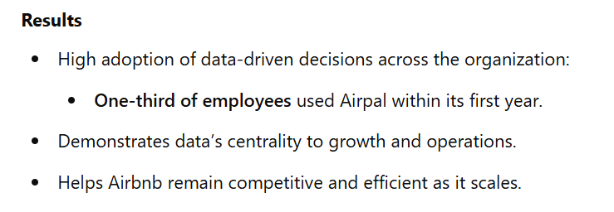

Slide 45
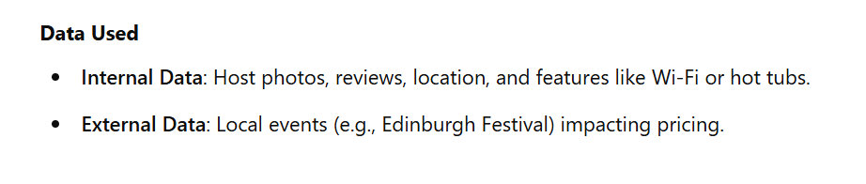

Slide 46
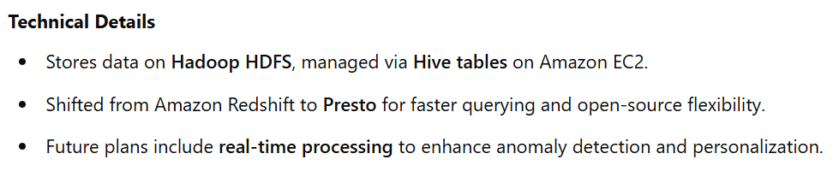

Slide 47
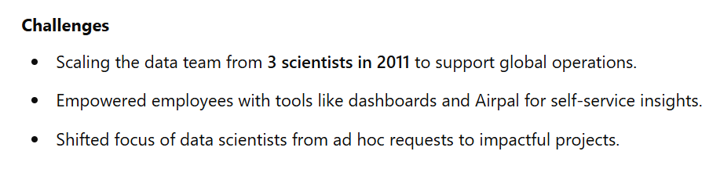

Slide 48
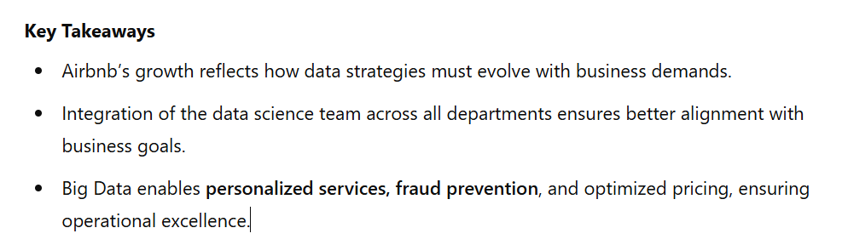

Slide 49


Slide 50
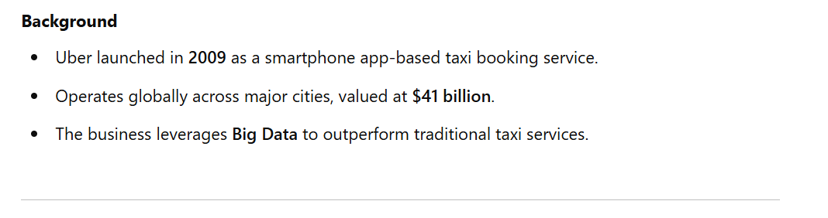
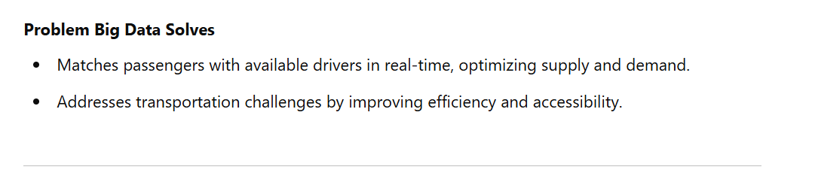

Slide 51
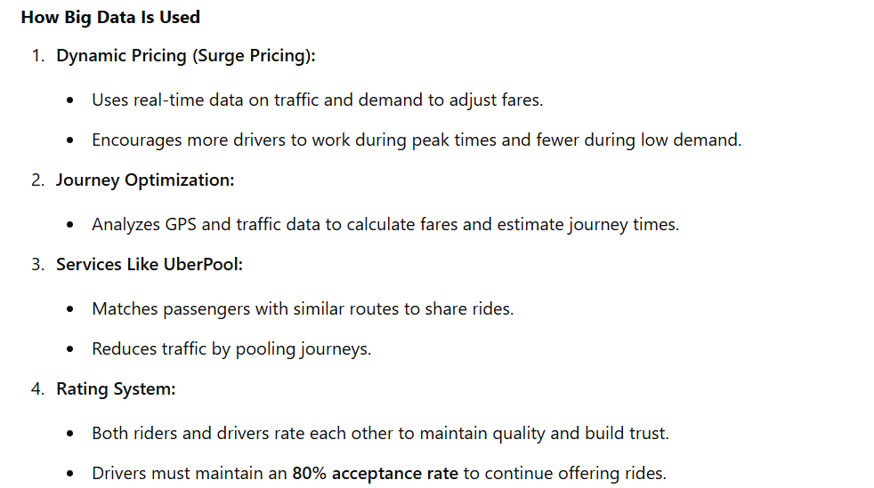

Slide 52
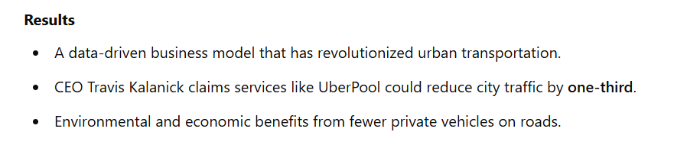
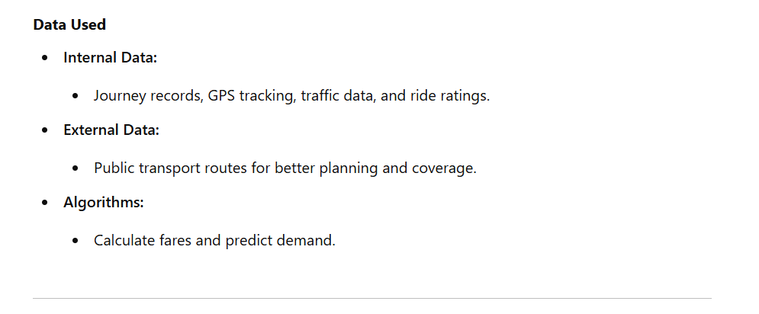

Slide 53



Slide 54


Slide 55
JOHN DEERE
ROYAL BANK OF SCOTLAND
LINKEDIN
MICROSOFT
ACXIOM
US IMMIGRATION AND CUSTOMS
NEST
GE
ETSY
NARRATIVE SCIENCE
BBC
MILTON KEYNES
PALANTIR
AIRBNB
SPRINT
DICKEY’S BARBECUE PIT
CAESARS
FITBIT
RALPH LAUREN
ZYNGA
AUTODESK
WALT DISNEY PARKS AND RESORTS
EXPERIAN
TRANSPORT FOR LONDON
THE US GOVERNMENT
IBM WATSON
GOOGLE
WALMART
CERN
NETFLIX
ROLLS-ROYCE
SHELL
APIXIO
LOTUS F1 TEAM
PENDLETON & SON BUTCHERS
US OLYMPIC WOMEN’S CYCLING TEAM
ZSL
FACEBOOK
TERRA SEISMIC
APPLE
TWITTER
UBER
ELECTRONIC ARTS
KAGGLE
AMAZON

